Slide 1
Natalie Sprint #2 Review
Connecting a Data Source
and Database using Python and PostgreSQL

Slide 2

Project Overview
Connect to HubSpot’s API and pull in all contact data.
Parse data in extract only certain fields to make new data structure.
Create PostgreSQL database with data model for business needs.
Use new data structure to insert values into existing table in a PostgreSQL database.

Slide 3
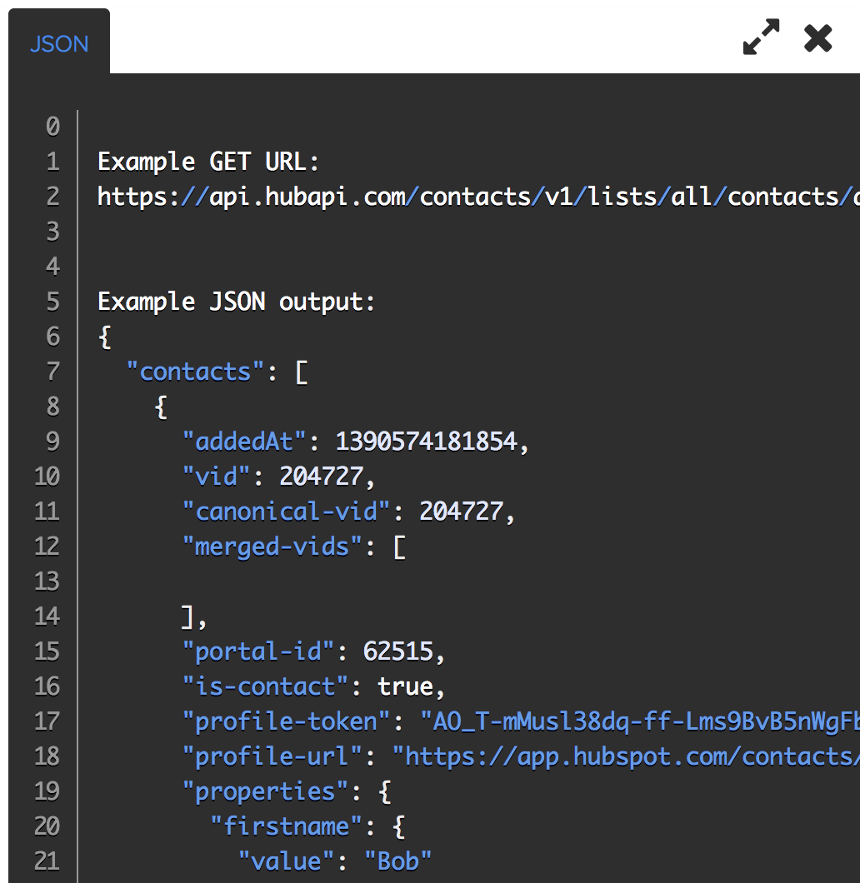
Accessing HubSpot’s API
Hubspot’s API documents were not extremely helpful, but they did provide examples of what an api call would look like.
They have an api called ’get all contacts’ which gives you on huge json object.
The object contained nested lists and dictionaries.

Slide 4
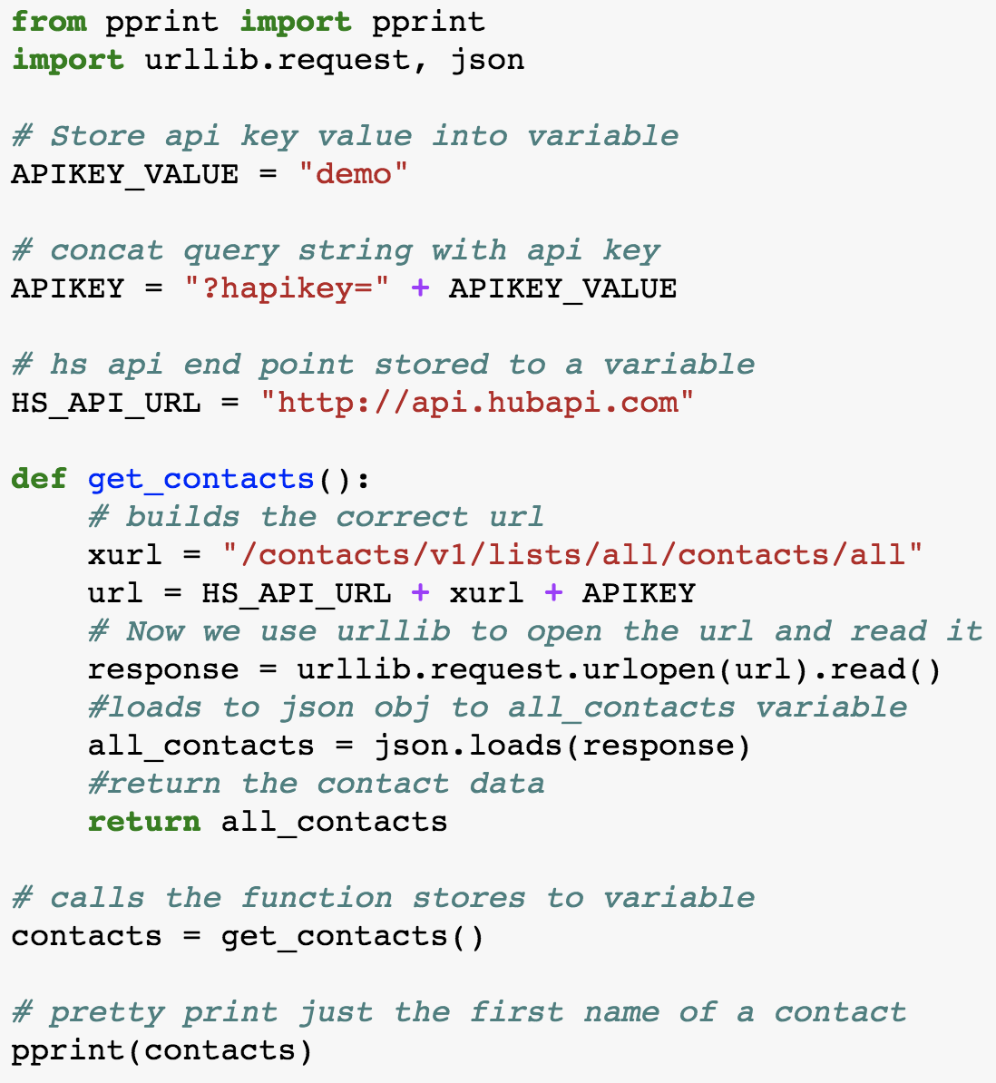
Python Script for HubSpot API
Python libraries used for this script:
pprint
urllib.request
Json
Used urllib.request to open and read api url
Used json.loads to load response into json
Invoked the function to load the list

Slide 5
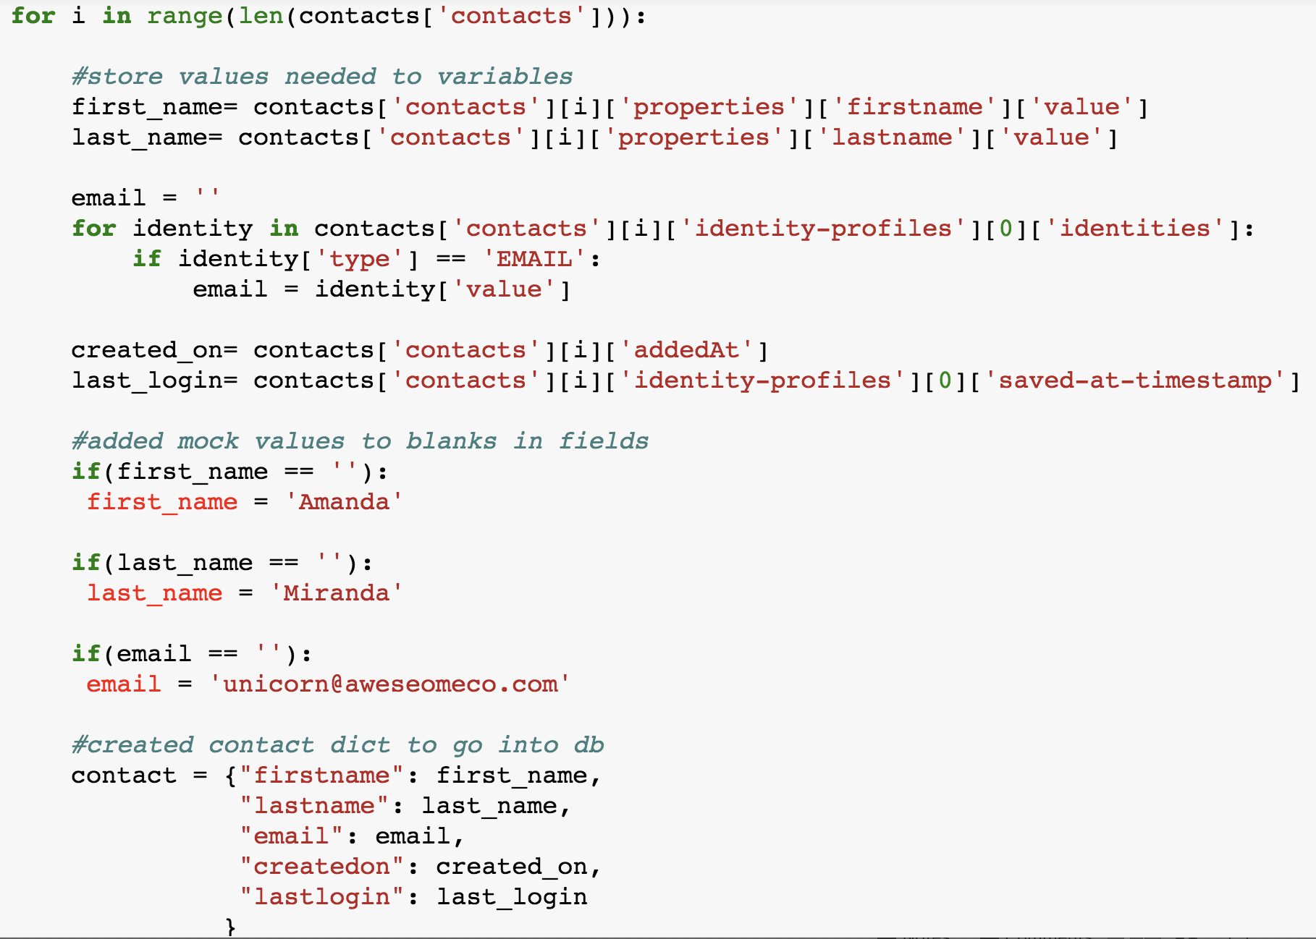
Looping through keys in Dictionary
Values needed were in nested lists and dictionaries within the json object.
Had to create for loop to go through the range of keys in the whole contact list
Wrote logic that extracted data and cleaned it
Formatted values extracted from json into new cleaned dictionary.

Slide 6
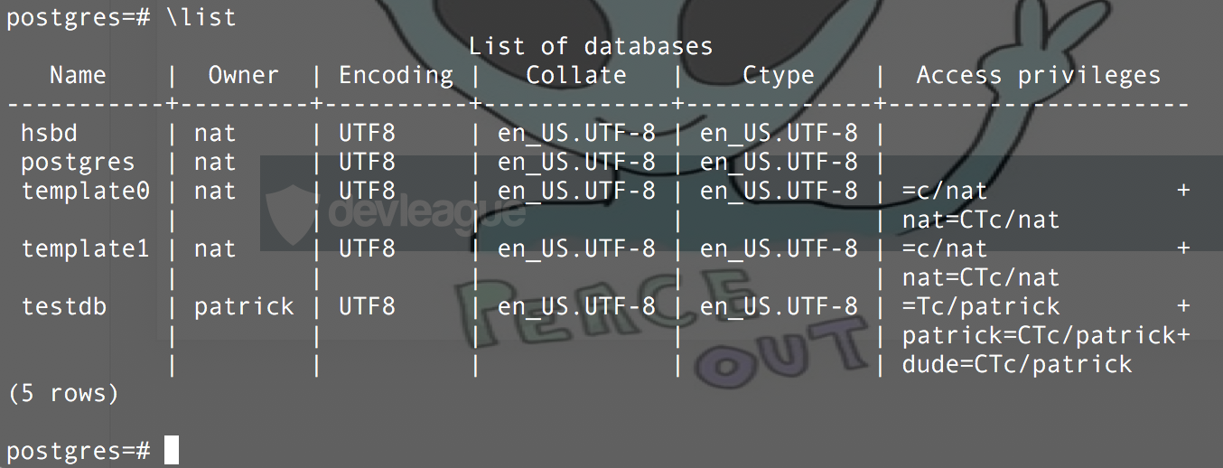
Setting up PostgreSQL Database

Slide 7
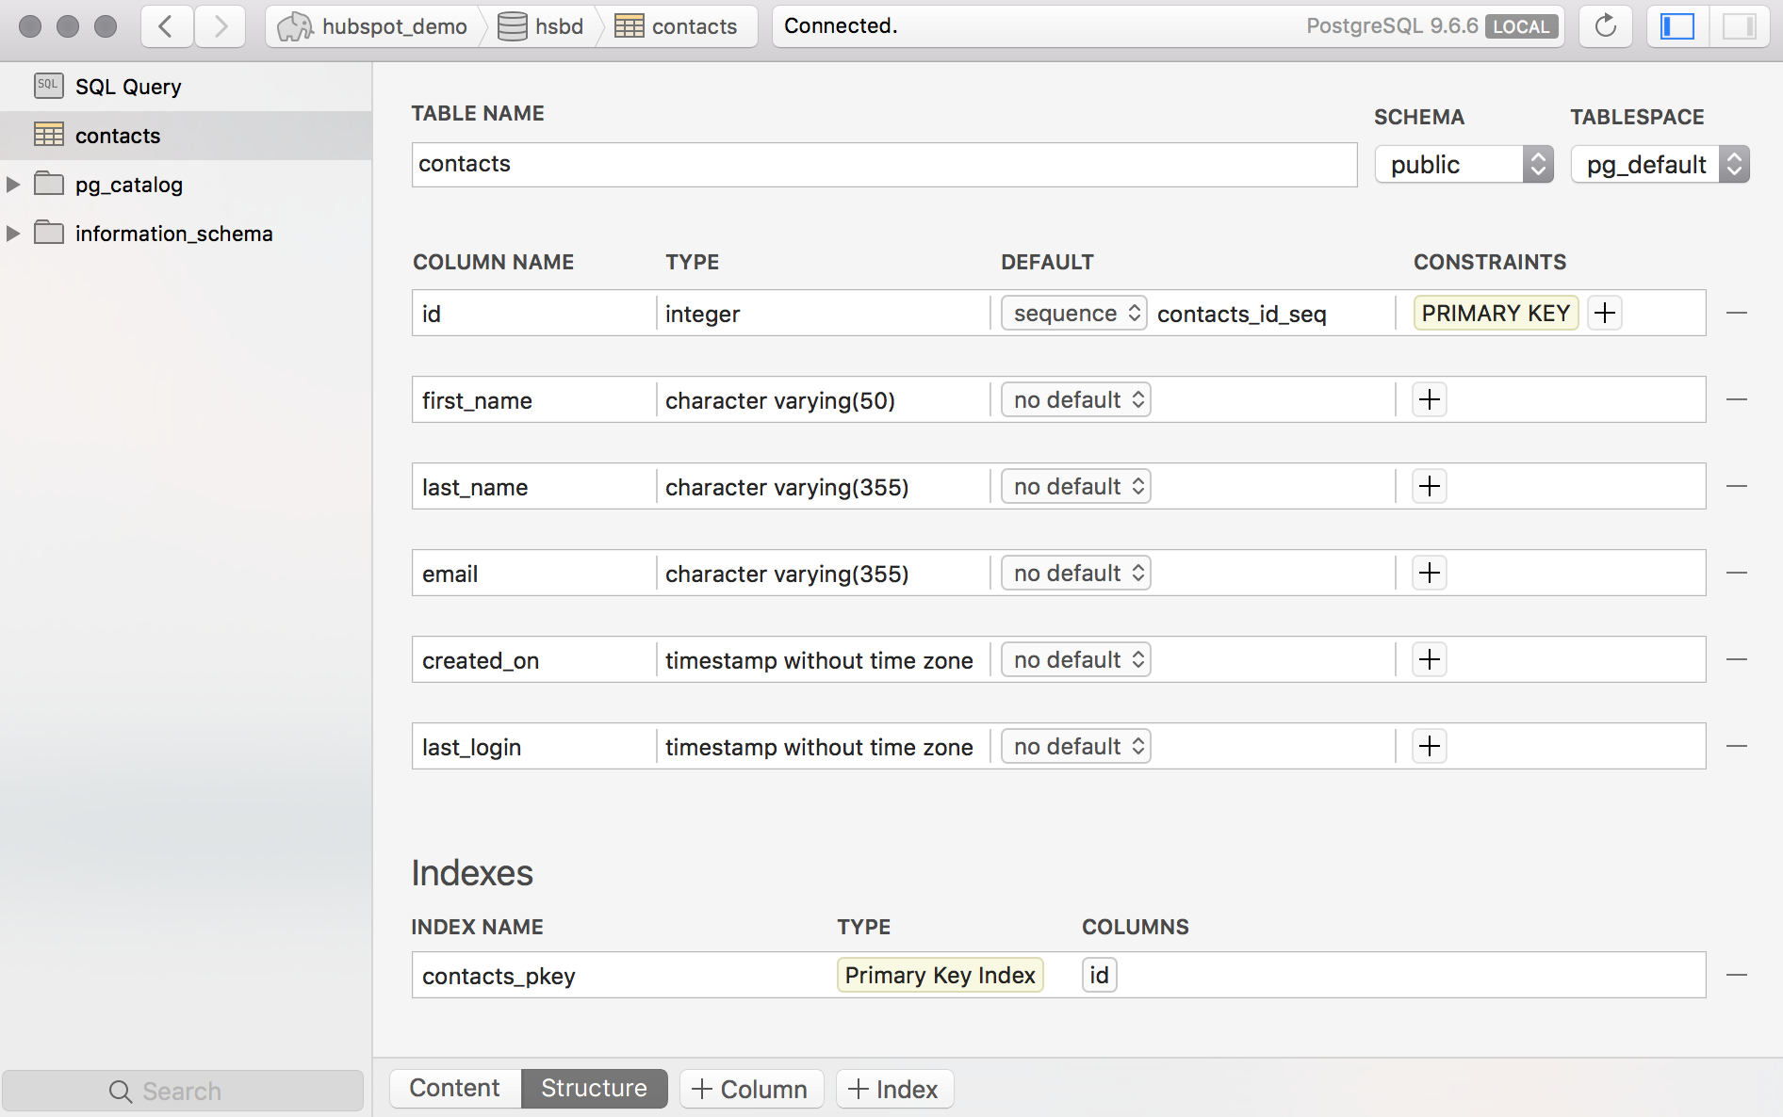
Setting up Postico GUI
Love POSTICO!!!
Easy to install and use
Easy to set up data model and tables
Allows same features as creating it from the command line

Slide 8
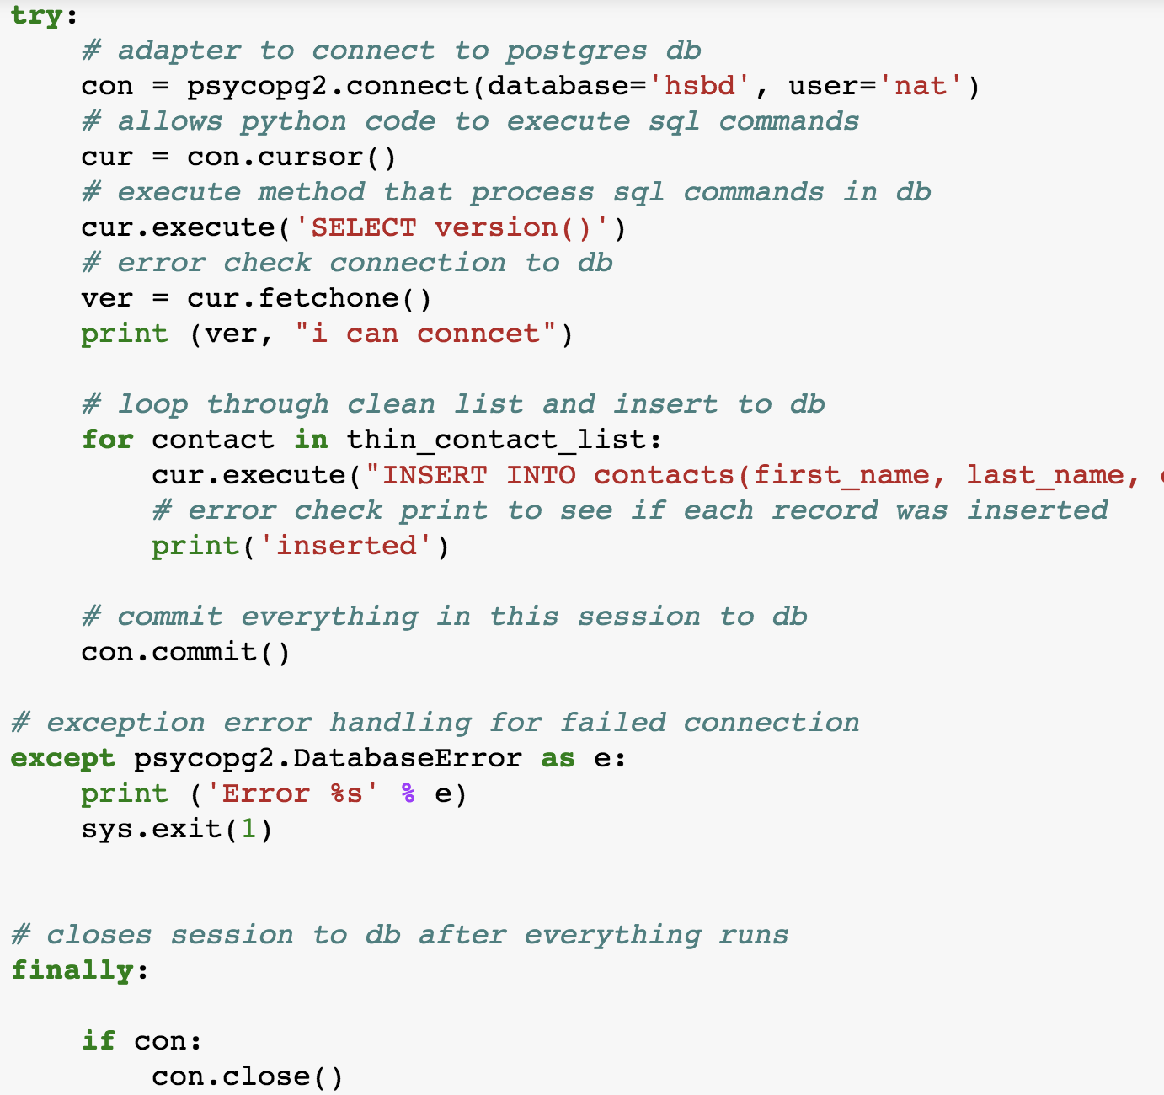
Connecting to Database with Python
Libraries Used:
psycopg2 to connect to PostgreSQL
sys to stop python script and exit database session
Used the execute method to run SQL commands.
Really useful library - was very easy to use.

Slide 9
Running Scripts in CLI VS. Jupyter
In Jupyter when you have multiple cells, as long as you’re in the same notebook it treats it like one big file.
When you run the files in the command line you have to create Modules
To connect files, all you have to do is connect files as you would import a library.

Slide 10
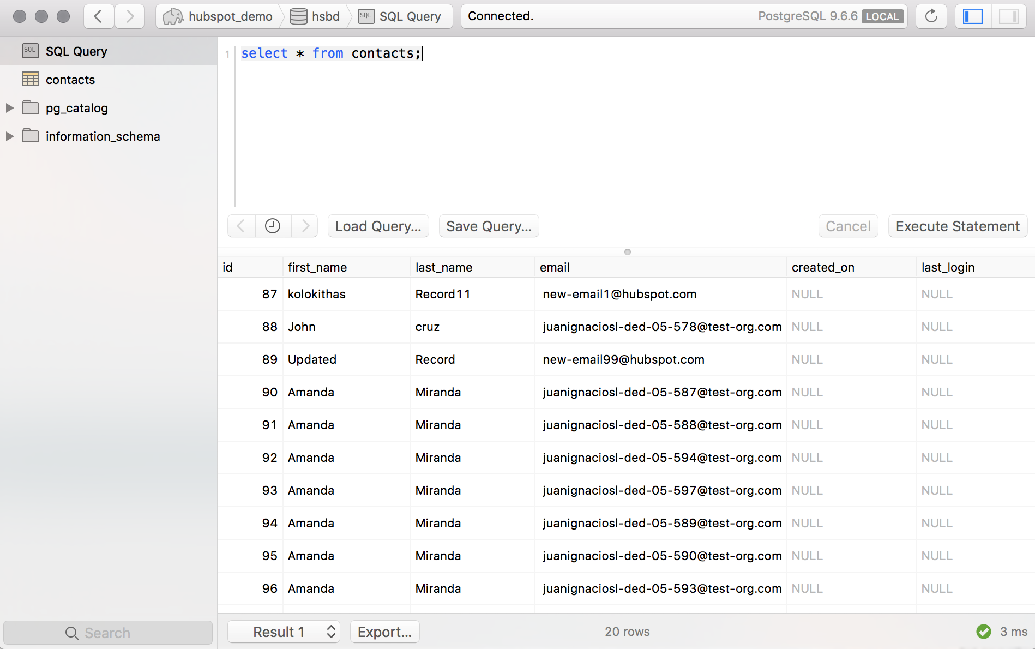
Results !!!!! ☺

Slide 11
Thank you

